Slide 1
Global Management Managing across Borders
Chapter 4

Slide 2
Major Questions You Should Be Able to Answer
4.1 What three important developments of globalization will probably affect me?
4.2 Why learn about international management, and what characterizes the successful international manager?
4.3 Why do companies expand internationally, and how do they do it?

Slide 3
Major Questions You Should Be Able to Answer
4.4 What are barriers to free trade, and what major organizations and trading blocs promote trade?
4.5 What are the principal areas of cultural differences?

Slide 4
Competition & Globalization: Who Will Be No. 1 Tomorrow?
Globalization
the trend of the world economy toward becoming a more interdependent system

Slide 5
The Rise of the “Global Village” & Electronic Commerce
Global village
the “shrinking” of time and space as air travel and the electronic media have made it much easier for the people of the globe to communicate with one another

Slide 6
The Rise of the “Global Village” & Electronic Commerce
E-commerce
the buying and selling of products and services through computer networks
U.S. retail e-commerce sales were estimated at $263.3 billion for 2013, up 16.9% over the previous year

Slide 7
One Big World Market: The Global Economy
Positive effects
world will be far more interconnected leading to better and more affordable products, as well as ever better communication among nations
Negative effects
the movement, or outsourcing, of formerly well-paying jobs overseas as companies seek cheaper labor costs, particularly in manufacturing

Slide 8
Notes:
Poll Title: Do not modify the notes in this section to avoid tampering with the Poll Everywhere activity. More info at polleverywhere.com/support Julian sells his art through his own web site and his etsy store. He receives questions from many different countries. Julian is engaged in _________. https://www.polleverywhere.com/multiple_choice_polls/vJpWMBwb8JyPeZ9MXl8ym?display_state=instructions&activity_state=opened&state=opened&flow=Instructor&onscreen=persist

Slide 9
Notes:
Poll Title: Do not modify the notes in this section to avoid tampering with the Poll Everywhere activity. More info at polleverywhere.com/support Julian sells his art through his own web site and his etsy store. He receives questions from many different countries. Julian is engaged in _________. https://www.polleverywhere.com/multiple_choice_polls/vJpWMBwb8JyPeZ9MXl8ym?display_state=chart&activity_state=closed&state=closed&flow=Instructor&onscreen=persist

Slide 10
Notes:
Poll Title: Do not modify the notes in this section to avoid tampering with the Poll Everywhere activity. More info at polleverywhere.com/support Julian sells his art through his own web site and his etsy store. He receives questions from many different countries. Julian is engaged in _________. https://www.polleverywhere.com/multiple_choice_polls/vJpWMBwb8JyPeZ9MXl8ym?display_state=chart&activity_state=closed&display=correctness&state=closed&flow=Instructor&onscreen=persist

Slide 11
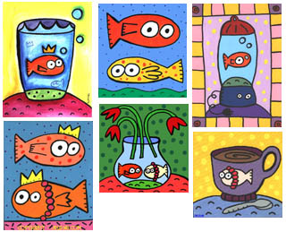
Question
Jelene sells her art through her own web site and her etsy store. She receives questions from many different countries. Jelene is engaged in _________.
E-commerce
Global trading
Counter-trading
Embargo
Notes:
The correct answer is “A” – e-commerce. See slide 4-6.

Slide 12
Why Learn About International Management?
You may deal with foreign customers or partners
You may deal with foreign employees or suppliers
You may work for a foreign firm in the United States
You may work for an American firm outside the United States – or for a foreign one

Slide 13
Being a Star Road Warrior
Lesson 1: Frequent travel may be needed because personal encounters are essential
Lesson 2: Travel may be global, but understanding must be local
Lesson 3: Travel downtime can be used to expand business contacts

Slide 14
Why Companies Expand Internationally
Availability of supplies
New markets
Lower labor costs
Access to finance capital
Avoidance of tariffs & import quotas
Notes:
Macquiladoras – manufacturing plants allowed to operate in Mexico with special privileges in return for employing Mexican citizens

Slide 15
Five Ways of Expanding Internationally
Figure 4.1

Slide 16
How Companies Expand Internationally
Global outsourcing
using suppliers outside the United States to provide labor, goods, or services
Also called offshoring

Slide 17
How Companies Expand Internationally
Importing
a company buys goods outside the country and resells them domestically
Exporting
a company produces goods domestically and sells them outside the country
Countertrading
bartering goods for goods

Slide 18
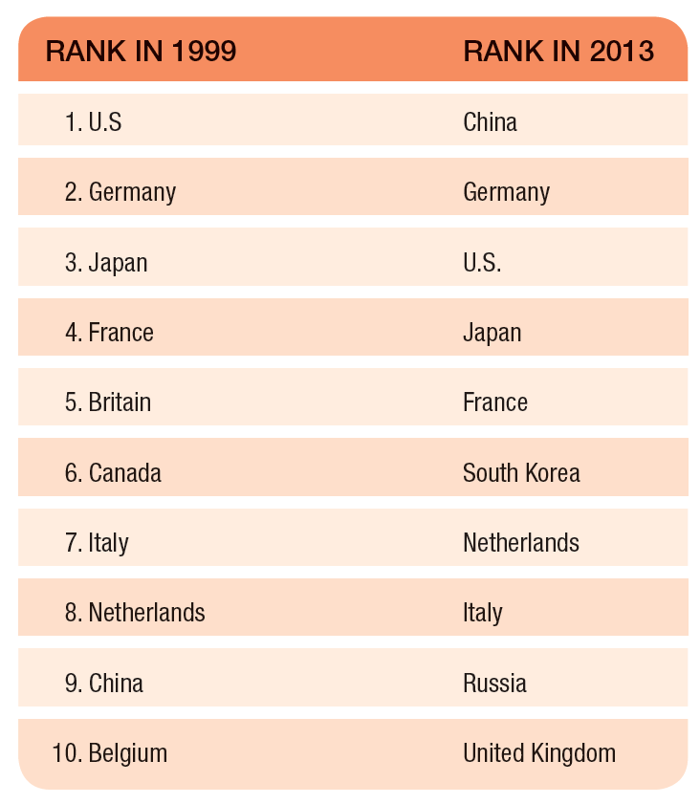
Top 10 exporting countries, 1999 and 2013
Table 4.2

Slide 19
How Companies Expand Internationally
Licensing
a company allows a foreign company to pay it a fee to make or distribute the firm’s product or service
Franchising
a company allows a foreign company to pay it a fee and a share of the profit in return for using the company’s brand name and a package of materials and services

Slide 20
How Companies Expand Internationally
Joint ventures
formed with a foreign company to share the risks and rewards of starting a new enterprise together in a foreign country
also known as a strategic alliance

Slide 21
How Companies Expand Internationally
Wholly-owned subsidiary
foreign subsidiary that is totally owned and controlled by an organization
Greenfield venture
a foreign subsidiary that the owning organization has built from scratch.
Notes:
Greenfield venture - foreign subsidiary that the owning organization has built from scratch

Slide 22
Barriers to International Trade
Tariffs
customs duty, or tax, levied mainly on imports
Import quotas
limits on the numbers of a product that can be imported
Embargoes
complete ban on the import or export of certain products
Notes:
Quotas are designed to prevent dumping – the practice of a foreign company’s exporting products abroad at a lower price than the price in the home market – or even below the costs of production – in order to drive down the price of the domestic product

Slide 23
Major Trading Blocs
Trading bloc
group of nations within a geographic region that have agreed to remove trade barriers with one another
also known as an economic community

Slide 24
Question
The U.S. does not allow the import of Cuban sugar and cigars. This is an example of a(n):
Embargo
Tariff
Quota
Maquiladora
Notes:
The correct answer is “A”
Page: LO: 5 Difficulty: Moderate
Rationale: This applies the definition of embargoes.
AACSB: 5, 6 BT: Comprehension

Slide 25
Notes:
Poll Title: Do not modify the notes in this section to avoid tampering with the Poll Everywhere activity. More info at polleverywhere.com/support The U.S. does not allow the import of Cuban sugar and cigars. This is an example of a(n): https://www.polleverywhere.com/multiple_choice_polls/WZHS63aJ64DcjBxVrL6w1?display_state=instructions&activity_state=opened&state=opened&flow=Instructor&onscreen=persist

Slide 26
Notes:
Poll Title: Do not modify the notes in this section to avoid tampering with the Poll Everywhere activity. More info at polleverywhere.com/support The U.S. does not allow the import of Cuban sugar and cigars. This is an example of a(n): https://www.polleverywhere.com/multiple_choice_polls/WZHS63aJ64DcjBxVrL6w1?display_state=chart&activity_state=closed&state=closed&flow=Instructor&onscreen=persist

Slide 27
The Importance of National Culture
Culture
shared set of beliefs, values, knowledge, and patterns of behavior common to a group of people

Slide 28
Cultural Dimensions: The GLOBE Project
Low-context culture
shared meanings are primarily derived from written and spoken words
High-context culture
people rely heavily on situational cues for meaning when communicating with others

Slide 29
The Globe Project’s Nine Cultural Dimensions
Power distance
how much unequal distribution of power should there be in organizations and society
Page 123 – Denmark, Netherlands low power distance
Uncertainty avoidance
how much should people rely on social norms and rules to avoid uncertainty Denmark HIGH! Deaf
Institutional collectivism
how much should leaders encourage and reward loyalty to the social unit

Slide 30
The Globe Project’s Nine Cultural Dimensions
In-group collectivism
how much pride and loyalty should people have for their family or organization
Gender egalitarianism
how much should society maximize gender role differences
Assertiveness
how confrontational and dominant should individuals be in social relationships

Slide 31
The Globe Project’s Nine Cultural Dimensions
Future orientation
how much should people delay gratification by planning and saving for the future
Performance orientation
how much should individuals be rewarded for improvement and excellence
Humane orientation
how much should society encourage and reward people for being kind, fair, friendly, and generous

Slide 32
Other Cultural Variations
Language
Interpersonal space
Communication
Time orientation
Monochronic, Polychronic
Religion
Law and political stability
Notes:
Monochronic time
preference for doing one thing at a time
Polychronic time
preference for doing more than one thing at a time

Slide 33
U.S. Managers on Foreign Assignments: Why Do They Fail?
Expatriates
people living or working in a foreign country
10%–20% of all U.S. managers sent abroad returned early because of job dissatisfaction or adjustment difficulties

