Slide 1
Principles of Management
Chapter 6 International Management

Slide 2
Learning Outcomes
After reading this chapter, you should be able to answer these questions:
Why is it important to understand and appreciate the importance of international management in today’s world?
What is culture, and how can culture be understood through Hofstede’s cultural framework?
Why is an understanding of cultural stereotyping important, and what can students do to prepare for cultural stereotyping by looking at social institutions?
What steps can you undertake to be better prepared for cross-cultural assignments?
What are the main strategies that companies can use to go international?
Why might it be necessary for a company to go international, and how might it accomplish this goal?

Slide 3
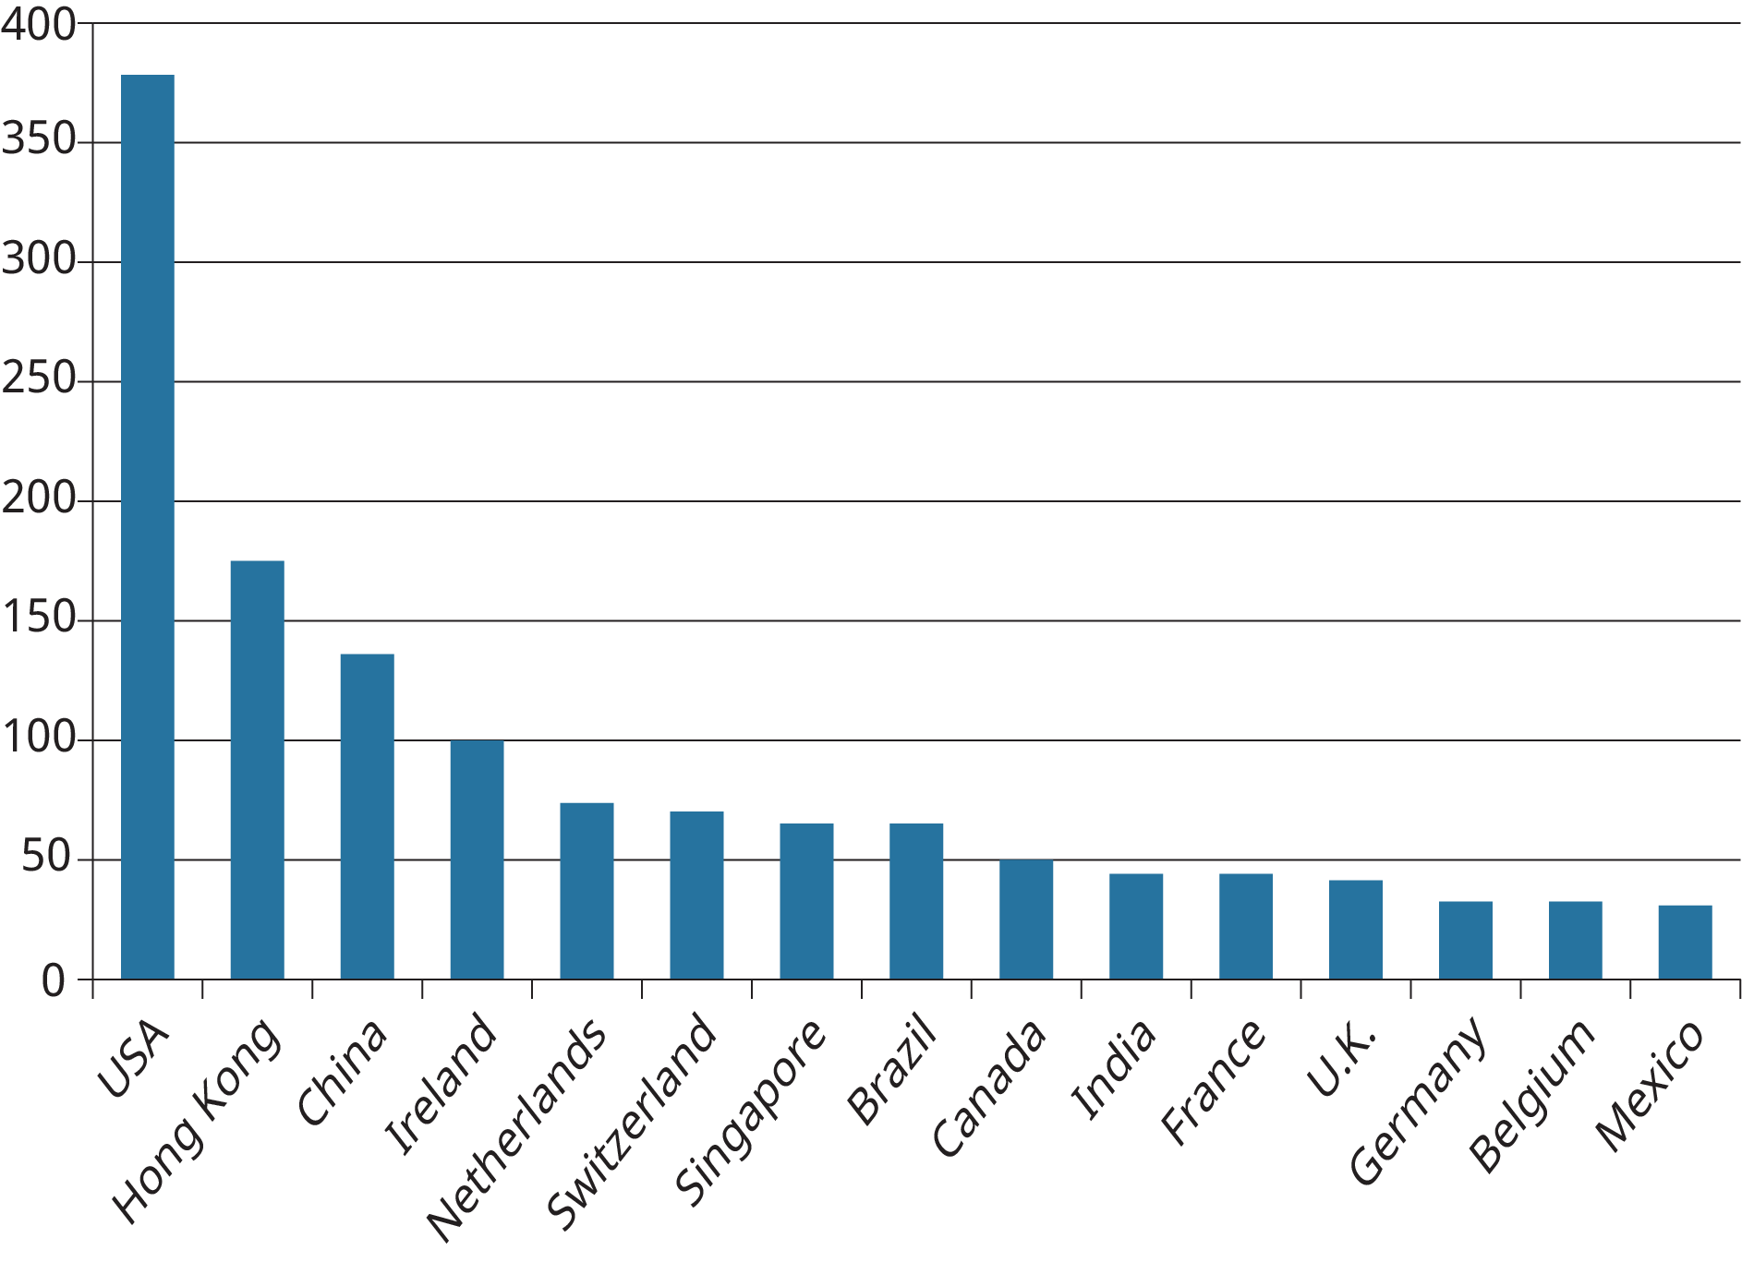
Exhibit 6.2 Foreign Direct Investment Inflows from Other Countries
Based on: UNCTAD, 2016, World Investment Report, 2016. (Attribution: Copyright Rice University, OpenStax, under CC-BY 4.0 license)

Slide 4
Table 6.1 Hofstede’s Model of National Culture
Countries | Power Distance | Individualism | Uncertainty Avoidance | Masculinity
Australia | Low | High | Low | High
Canada | Low | High | Low | High
China | High | Low | Medium | Medium
Germany | Low | High | Medium | High
Mexico | High | Medium | High | High
France | High | High | High | Low
Spain | Medium | Medium | High | Low
Greece | Medium | Medium | High | Medium
Denmark | Low | High | Low | Low
Finland | Low | High | Medium | Low
Brazil | High | Medium | Medium | Medium
India | High | Medium | Low | Medium
Japan | Low | Medium | High | High
U.K. | Low | High | Low | High
U.S.A. | Low | High | Low | High
Adapted from Geert Hofstede, “Culture’s consequences: Comparing values, behaviors and institutions across nations,” 2nd edition, 2001, Thousand Oaks, CA: Sage Publications.
(Attribution: Copyright Rice University, OpenStax, under CC-BY 4.0 license)

Slide 5
Table 6.2 Implications of Power Distance PAGE 166
Type of Work Activity | High Power Distance | Low Power Distance
Organizational structures | Very centralized Tall hierarchies with clear levels of managers and subordinates | Flat organizational hierarchies Decentralized structures
Managerial authority | Concentration of authority at the top Managers rely on formal rules to manage Authoritative managerial style and decision making | Dispersed authority Managers rely on personal experience More consultative or collaborative forms of decision making
Relationship with supervisors | Subordinates expect to be told what to do Perfect boss is seen as one who is an autocrat Information sharing constrained by hierarchy | Subordinates often expected to be consulted Ideal manager is seen as a democratic leader Openness to sharing information
Other issues | Wide salary gap between top and bottom of organization Managers often feel underpaid and dissatisfied with careers | Low salary gap between top and bottom of company Managers feel paid adequately and are satisfied
Adapted from Geert Hofstede, “Culture’s consequences: Comparing values, behaviors and institutions across nations,” 2nd edition, 2001, page 107-108, Thousand Oaks, CA: Sage Publications.
(Attribution: Copyright Rice University, OpenStax, under CC-BY 4.0 license)

Slide 6
Table 6.3 Implications of Individualism
Type of Work Activity | Low Individualism/High Collectivism | High Individualism/Low Collectivism
Relationship with companies | Employees act in the interest of in-group (members of the family or same university) Employee commitment to company relatively low Employee-employer relationships is almost like a family link | Employees act in their own interests Employee commitment to organizations high Employee-employer relationship based on the market
Human resource, management | Hiring and promotion takes in-group into consideration Better to reward based on equality (give everyone the same reward) rather than equity (base reward on work effort) Relatives of employees preferred in hiring Training best when focused at group level | Hiring and promotions based on rules Family relationships unimportant in hiring Better to reward based on equity Training done best individually
Other issues | Belief in collective decisions Treating friends better than others is normal Support of teamwork Less mobility across occupations Personal relationships very critical in business | Belief in individual decision making Treating friends better than others at the workplace is considered unethical More mobility across occupations within company Tasks and company prevail over personal relationships in business
Adapted from Geert Hofstede, “Culture’s consequences: Comparing values, behaviors and institutions across nations,” 2nd edition, 2001, page 169-170, Thousand Oaks, CA: Sage Publications.

Slide 7
Handshake Etiquette Around the World.
At the end of Section 6.3 there is a grey box titled MANAGING CHANGE, with the subheading: Negotiations in Malaysia and China. What you probably noticed was that the person in the scenario, who is actually said to be “you”, failed to build the necessary relationships with both the Malaysian and Chinese executives in the way these people expected. Check out this video about handshake etiquette around the world.

Slide 8
5. What steps can you take to be better prepared for cross-cultural assignments?
Concept Check
How should training for cross-cultural assignments be implemented?
Japanese business cards
Danish Beers on Friday at 2:30
Dutch coffee / water
German precise, Australians relaxed, Italian emotional
Notes:
Japanese business cards
Danish Beers on Friday at 2:30
Dutch coffee / water

Slide 9
7. Why might it be necessary for a company to go international, and how might it accomplish this goal?
Concept Check
What are the factors and approaches that organizations can take when deciding to go global?
License, Franchise (page 191, 192)
This OpenStax ancillary resource is © Rice University under a CC-BY 4.0 International license; it may be reproduced or modified but must be attributed to OpenStax, Rice University and any changes must be noted.

