Slide 1
Principles of Management
Chapter 6 International Management

Slide 2
Learning Outcomes
After reading this chapter, you should be able to answer these questions:
Why is it important to understand and appreciate the importance of international management in today’s world?
What is culture, and how can culture be understood through Hofstede’s cultural framework?
Why is an understanding of cultural stereotyping important, and what can students do to prepare for cultural stereotyping by looking at social institutions?
What steps can you undertake to be better prepared for cross-cultural assignments?
What are the main strategies that companies can use to go international?
Why might it be necessary for a company to go international, and how might it accomplish this goal?

Slide 3
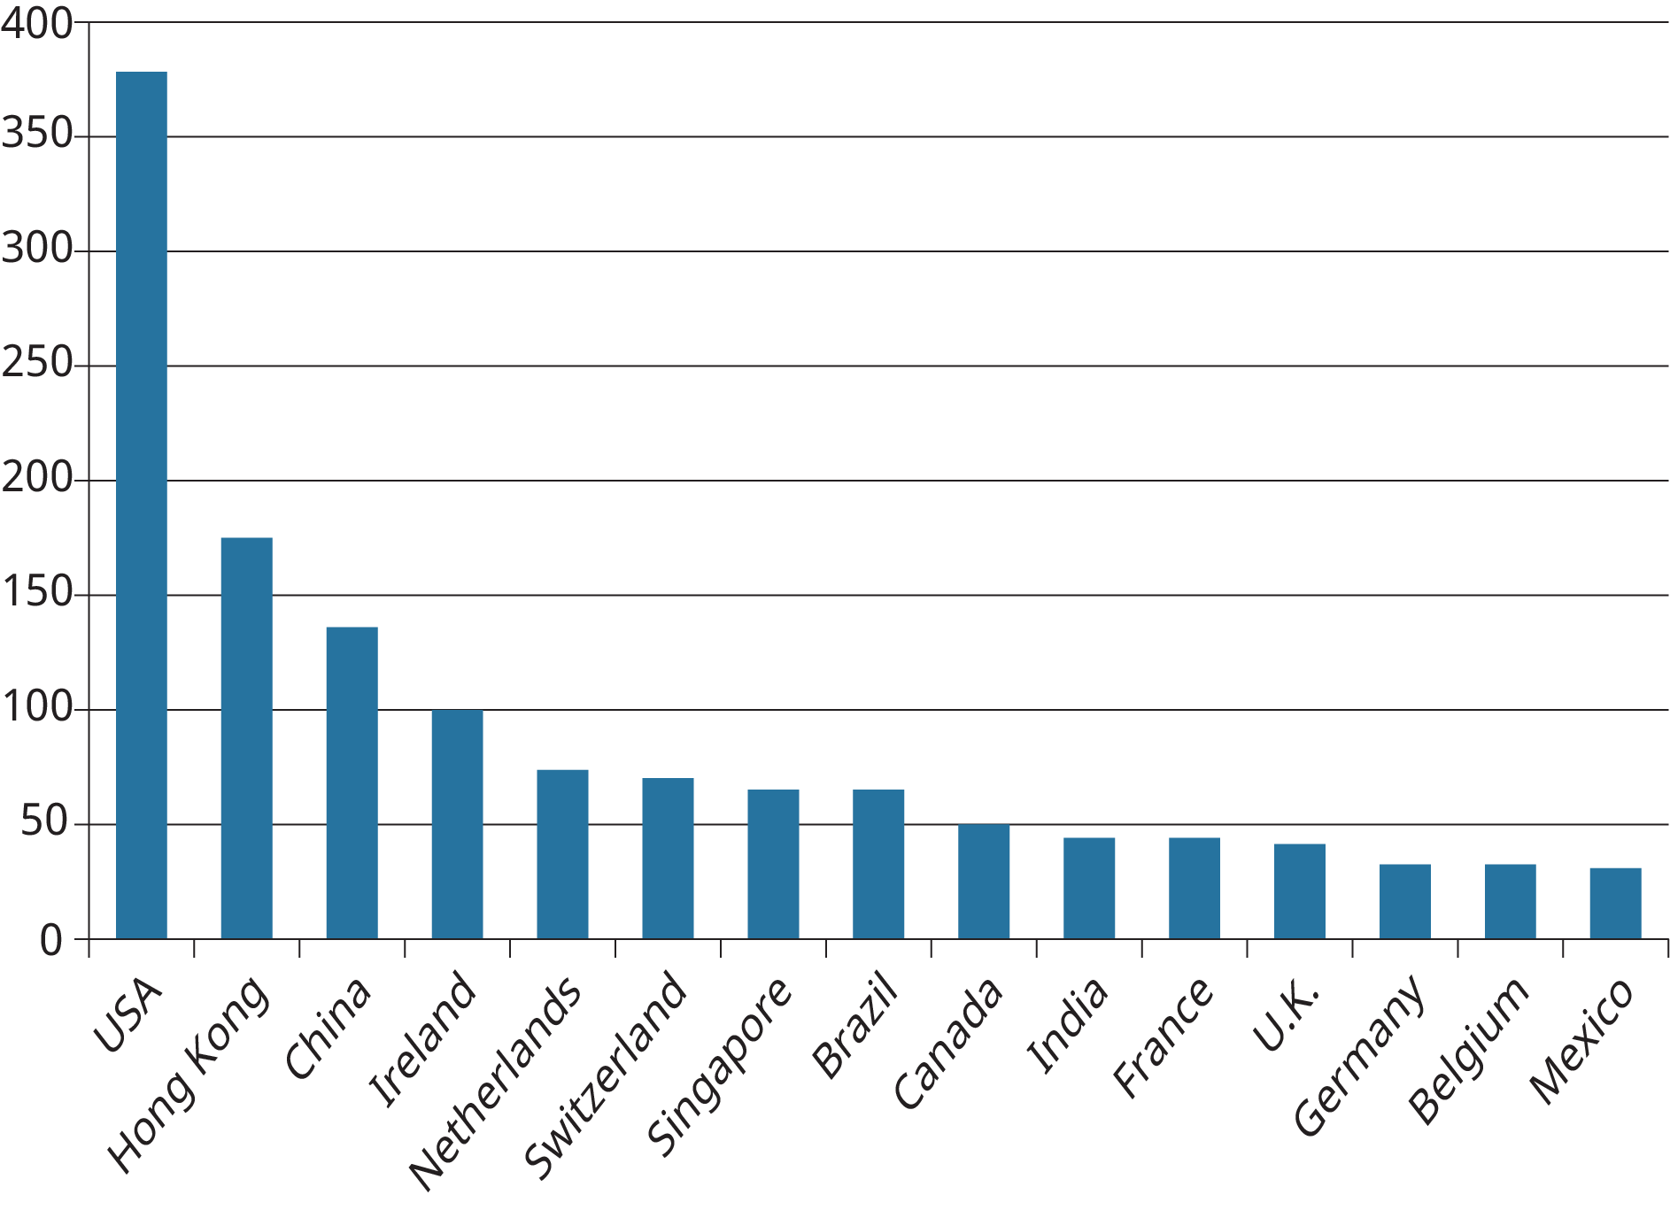
Exhibit 6.2 Foreign Direct Investment Inflows from Other Countries
Based on: UNCTAD, 2016, World Investment Report, 2016. (Attribution: Copyright Rice University, OpenStax, under CC-BY 4.0 license)

Slide 4
1. Why is it important to understand and appreciate the importance of international management in today’s world?
Concept Check
Describe the lowering of trade barriers and its impact on international business.
What is foreign direct investment?
What has the role of the Internet had on international business?

Slide 5
Table 6.1 Hofstede’s Model of National Culture
Countries | Power Distance | Individualism | Uncertainty Avoidance | Masculinity
Australia | Low | High | Low | High
Canada | Low | High | Low | High
China | High | Low | Medium | Medium
Germany | Low | High | Medium | High
Mexico | High | Medium | High | High
France | High | High | High | Low
Spain | Medium | Medium | High | Low
Greece | Medium | Medium | High | Medium
Denmark | Low | High | Low | Low
Finland | Low | High | Medium | Low
Brazil | High | Medium | Medium | Medium
India | High | Medium | Low | Medium
Japan | Low | Medium | High | High
U.K. | Low | High | Low | High
U.S.A. | Low | High | Low | High
Adapted from Geert Hofstede, “Culture’s consequences: Comparing values, behaviors and institutions across nations,” 2nd edition, 2001, Thousand Oaks, CA: Sage Publications.
(Attribution: Copyright Rice University, OpenStax, under CC-BY 4.0 license)

Slide 6
Table 6.2 Implications of Power Distance PAGE 166
Type of Work Activity | High Power Distance | Low Power Distance
Organizational structures | Very centralized Tall hierarchies with clear levels of managers and subordinates | Flat organizational hierarchies Decentralized structures
Managerial authority | Concentration of authority at the top Managers rely on formal rules to manage Authoritative managerial style and decision making | Dispersed authority Managers rely on personal experience More consultative or collaborative forms of decision making
Relationship with supervisors | Subordinates expect to be told what to do Perfect boss is seen as one who is an autocrat Information sharing constrained by hierarchy | Subordinates often expected to be consulted Ideal manager is seen as a democratic leader Openness to sharing information
Other issues | Wide salary gap between top and bottom of organization Managers often feel underpaid and dissatisfied with careers | Low salary gap between top and bottom of company Managers feel paid adequately and are satisfied
Adapted from Geert Hofstede, “Culture’s consequences: Comparing values, behaviors and institutions across nations,” 2nd edition, 2001, page 107-108, Thousand Oaks, CA: Sage Publications.
(Attribution: Copyright Rice University, OpenStax, under CC-BY 4.0 license)

Slide 7
Table 6.3 Implications of Individualism
Type of Work Activity | Low Individualism/High Collectivism | High Individualism/Low Collectivism
Relationship with companies | Employees act in the interest of in-group (members of the family or same university) Employee commitment to company relatively low Employee-employer relationships is almost like a family link | Employees act in their own interests Employee commitment to organizations high Employee-employer relationship based on the market
Human resource, management | Hiring and promotion takes in-group into consideration Better to reward based on equality (give everyone the same reward) rather than equity (base reward on work effort) Relatives of employees preferred in hiring Training best when focused at group level | Hiring and promotions based on rules Family relationships unimportant in hiring Better to reward based on equity Training done best individually
Other issues | Belief in collective decisions Treating friends better than others is normal Support of teamwork Less mobility across occupations Personal relationships very critical in business | Belief in individual decision making Treating friends better than others at the workplace is considered unethical More mobility across occupations within company Tasks and company prevail over personal relationships in business
Adapted from Geert Hofstede, “Culture’s consequences: Comparing values, behaviors and institutions across nations,” 2nd edition, 2001, page 169-170, Thousand Oaks, CA: Sage Publications.

Slide 8
Table 6.4 Implications of Uncertainty Avoidance
Type of Work Activity | Low Uncertainty Avoidance | High Uncertainty Avoidance
Relationship with companies | Weak loyalty to companies Average duration of employment shorter Preference for smaller organizations | Strong loyalty to employing organizations Employment are long term in duration Preference for larger companies
Characteristics of supervisors/managers | Superiors optimistic about subordinate ambition and leadership abilities Top managers usually involved in strategy Power of superiors based on relationships and position Transformational leaders preferred | Superiors pessimistic about subordinate ambition Top managers often involved in operations Power of superiors based on control of uncertainties Hierarchical control roles preferred
Entrepreneurship and innovation | Innovators feel less constrained by rules Renegade championing Tolerance for ambiguity in procedures and structures Innovation welcomed | Innovators feel constrained by rules Rational championing Formalized management structures Innovation resisted
Based on Geert Hofstede, “Culture’s consequences: Comparing values, behaviors and institutions across nations,” 2nd edition, 2001, page 169-170, Thousand Oaks, CA: Sage Publications.

Slide 9
2. What is culture, and how can culture be understood through Hofstede’s cultural framework?
Concept Check
Describe Hofstede’s approach to defining national culture.
Describe power distance and its implications for managers in in cultural contexts.
Describe individualism versus collectivism and its implications for managers in cultural contexts.
Describe uncertainty avoidance and its implications for managers in in cultural contexts.

Slide 10
Hofstede's Cultural Dimensions
View the video summary from Mad English TV of Hofstede's Cultural Dimensions

Slide 11
Table 6.6 Country Clusters
Confucian Asia | Germanic Europe | Latin America | Nordic Europe | Middle East | Sub-Saharan Africa
Australia Canada Ireland New Zealand South Africa (White) United Kingdom United States | China Hong Kong Japan Singapore South Korea Taiwan | Austria Switzerland Netherlands Germany (former East) Germany (former West) | Argentina Bolivia Brazil Colombia Costa Rica El Salvador Guatemala Mexico Venezuela | Denmark Finland Sweden | Qatar Morocco Turkey Egypt Kuwait | Namibia Nigeria South Africa (Black) Zambia Zimbabwe
Based on Dorfman, P., Paul J. Hanges, and F. C. Brodbeck. 2004. “Leadership and cultural variation: The identification of culturally endorsed leadership profiles.” In R. J. House, P. J. Hanges, M. Javidan, P. W. Dorfman, and V. Gupta, eds. Culture, Leadership, and Organizations. Thousand Oaks, CA: Sage Publications, 669–720.

Slide 12
Table 6.7 Country Clusters and Preferred Leadership Styles
Leadership Style | Anglo | Confucian Asia | Germanic Europe | Latin America | Middle East | Nordic Europe | Sub-Saharan Africa
Charismatic | High | Medium | High | High | Low | High | Medium
Team-oriented | Medium | Medium/ High | Medium/Low | High | Low | Medium | Medium
Participative | High | Low | High | Medium | Low | High | High
Humane-oriented | High | Medium/ High | Medium | Medium | Medium | Low | Medium
Autonomous | Medium | Medium | High | Low | Medium | Medium | Low
Self-protective | Low | High | Low | Medium/ High | High | Low | Medium
Based on Dorfman, P., Paul J. Hanges, and F. C. Brodbeck. 2004. “Leadership and cultural variation: The identification of culturally endorsed leadership profiles.” In R. J. House, P. J. Hanges, M. Javidan, P. W. Dorfman, and V. Gupta, eds. Culture, Leadership, and Organizations. Thousand Oaks, CA: Sage Publications, 669–720.

Slide 13
Table 6.8 Traits and Behaviors That Are Universally Admired and Disliked
Positively-Regarded Traits and Behaviors across the World
Trustworthy | Dependable
Intelligent | Just
Honest | Decisive
Plans ahead | Effective bargainer
Encouraging | Win-win problem solver
Positive | Skilled administrator
Dynamic | Communicator
Motivator | Informed
Confidence builder | Team builder
Negatively-Regarded Traits and Behaviors across the World
Loner | Egocentric
Antisocial[what does this mean? is it different from antisocial? | Ruthless
Not cooperative | Dictatorial
Nonexplicit
Based on Den Hartog, Deanne N., Robert J. House, Paul J. Hanges, Peter W. Dorfman, S. Antonio Ruiz-Quintanna, and 170 associates. 1999. “Culture specific and cross-culturally generalizable implicit leadership theories: Are attributes of charismatic/transformational leadership universally endorsed?” Leadership Quarterly, 10, 219–256.

Slide 14
3. How are regions of the world categorized using the GLOBE framework, and how does this categorization enhance understanding of cross-cultural leadership?
Concept Check
Describe how the GLOBE tools can be used by managers to prepare for cross-national situations.
What are the similarities and differences among clusters?

Slide 15
Handshake Etiquette Around the World.
At the end of Section 6.3 there is a grey box titled MANAGING CHANGE, with the subheading: Negotiations in Malaysia and China. What you probably noticed was that the person in the scenario, who is actually said to be “you”, failed to build the necessary relationships with both the Malaysian and Chinese executives in the way these people expected. Check out this video about handshake etiquette around the world.

Slide 16
Handshake Etiquette Around the World.
What is the correct handshake etiquette in Australia, is it the same as the USA or does it depend on gender?
What about in China, or the UAE?
Did you notice any other differences mentioned for the UK or France?

Slide 17
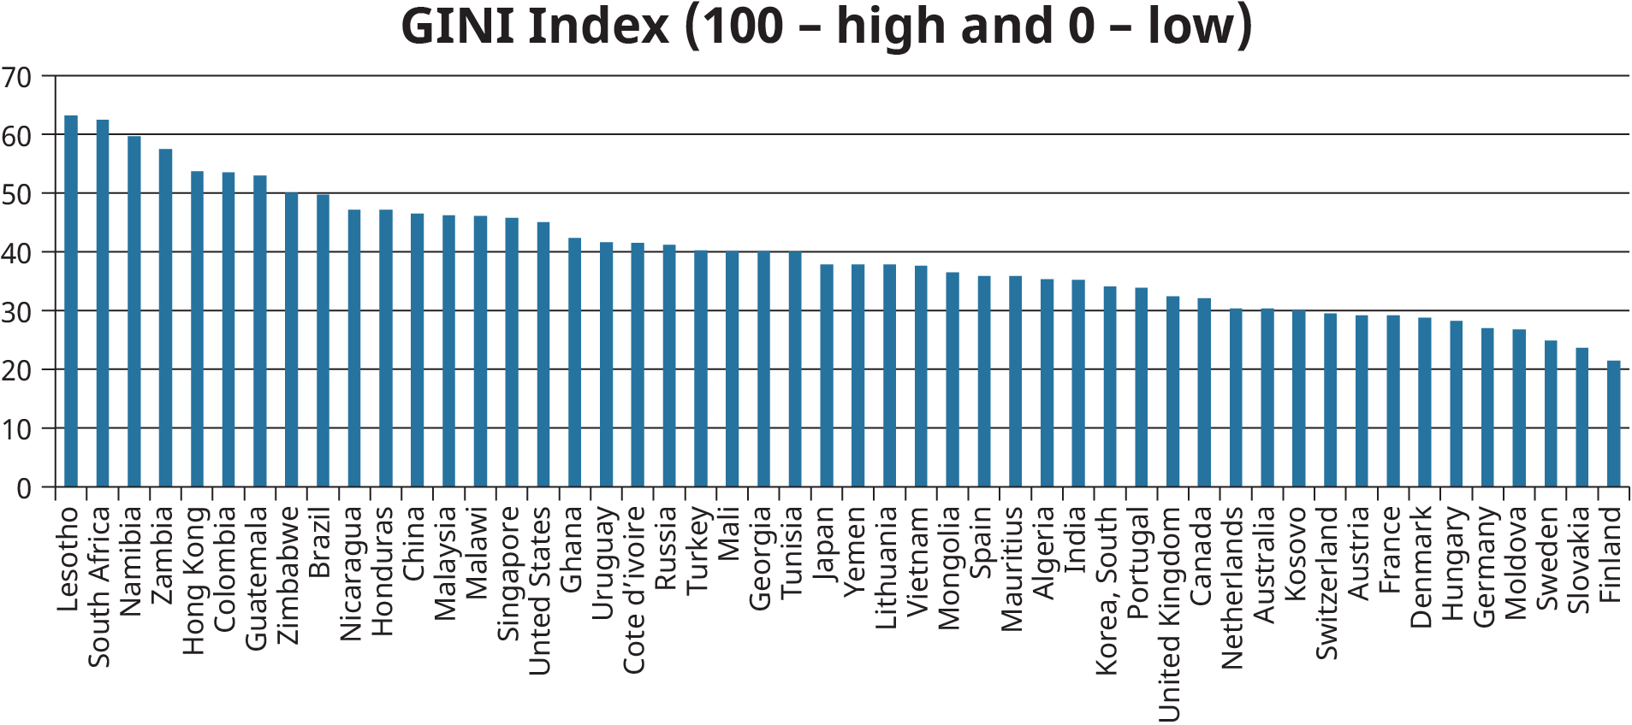
Exhibit 6.5 Level of Social Inequality
Based on CIA World Factbook - https://www.cia.gov/library/publications/the-world-factbook/rankorder/2172rank.html

Slide 18
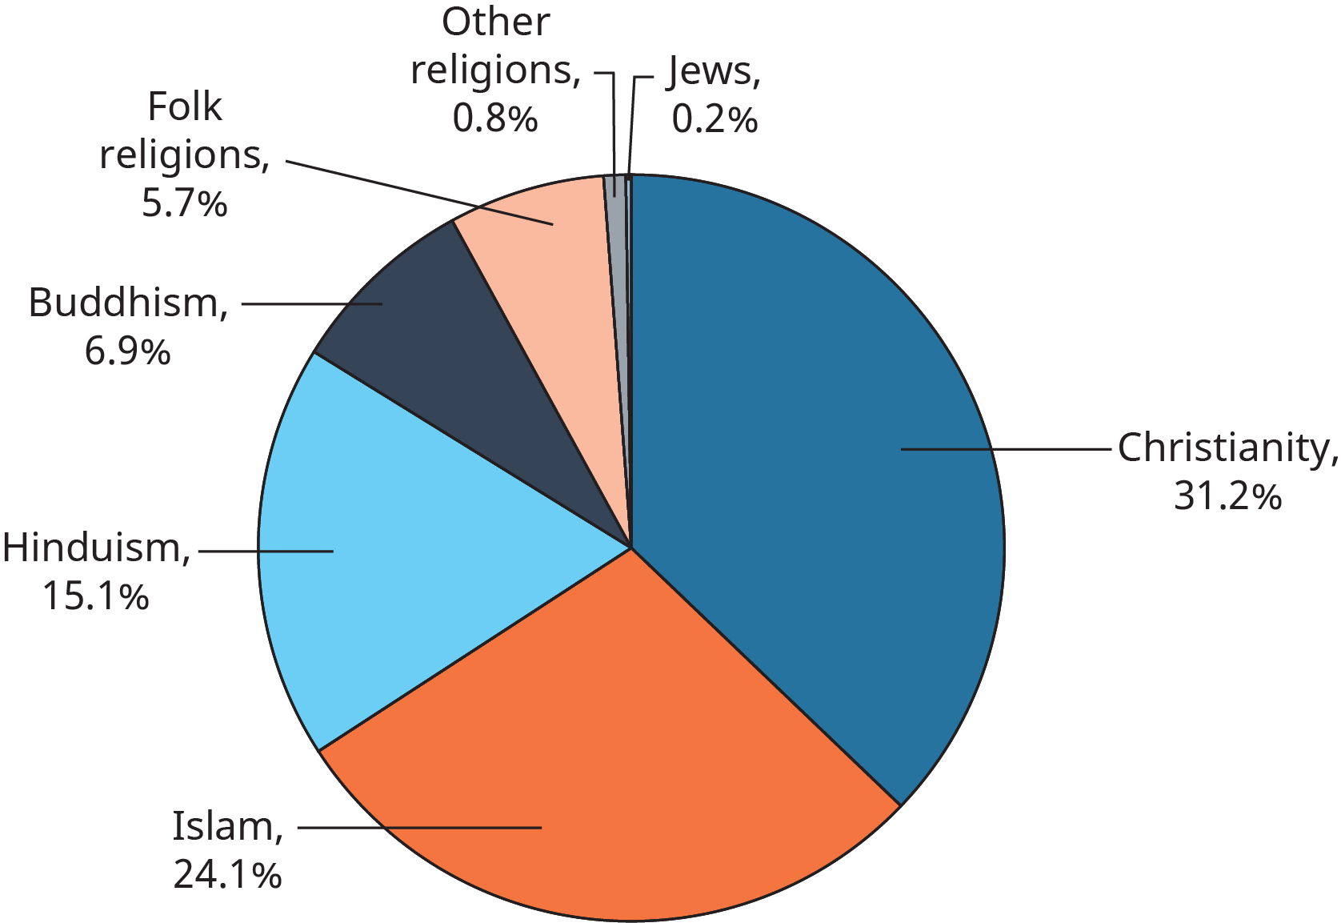
Exhibit 6.6 Religions of the World
Based on Pew Research: http://www.pewresearch.org/fact-tank/2017/04/05/christians-remain-worlds-largest-religious-group-but-they-are-declining-in-europe/

Slide 19
Why I am Untouchable
View the video interview with Sujatha Gidla, who was born into India's lowest social caste, the untouchables.

Slide 20
Why I am Untouchable
Now living in the USA, this woman’s description of her experience seems to have left permanent emotional scars, would you agree?
What about the untouchables, is there only one type or did you learn that different sub-categories of untouchables seem to work in specific jobs or industries? What kind was Sujatha Gidl?

Slide 21
5. What steps can you take to be better prepared for cross-cultural assignments?
Concept Check
How should training for cross-cultural assignments be implemented?
Japanese business cards
Danish Beers on Friday at 2:30
Dutch coffee / water
German precise, Australians relaxed, Italian emotional
Notes:
Japanese business cards
Danish Beers on Friday at 2:30
Dutch coffee / water

Slide 22
6. What are the main strategies that companies can use to go international?
Concept Check
How and why do companies take various approaches to global operations?

Slide 23
Table 6.10 Myths About Exporting and Counterarguments
Myths | Reality
Exporting is risky. | Selling domestically is as difficult as exporting to some markets. Additionally, not all markets are necessarily risky.
It is difficult to get paid for exports. | Buying and selling internationally is now fairly routine. There are numerous ways to ensure reliable payment.
Exporting is so complicated. | Exporting requires minimal paperwork. It is now very easy to search for buyers using the internet. There are many intermediaries available to help with exports.
I can’t succeed because I don’t speak another language. | As mentioned in the chapter, there are many organizations offering help with translation etc. Setting up global websites can be seamless now.
My product won’t do well in other markets. | If you do well in the U.S., your product will probably do well in other countries. There are many services available to test the market.
Based on U.S Department of Commerce, "A basic guide to exporting," 11th edition, 2015, https://www.export.gov/article?id=Why-Companies-should-export

Slide 24
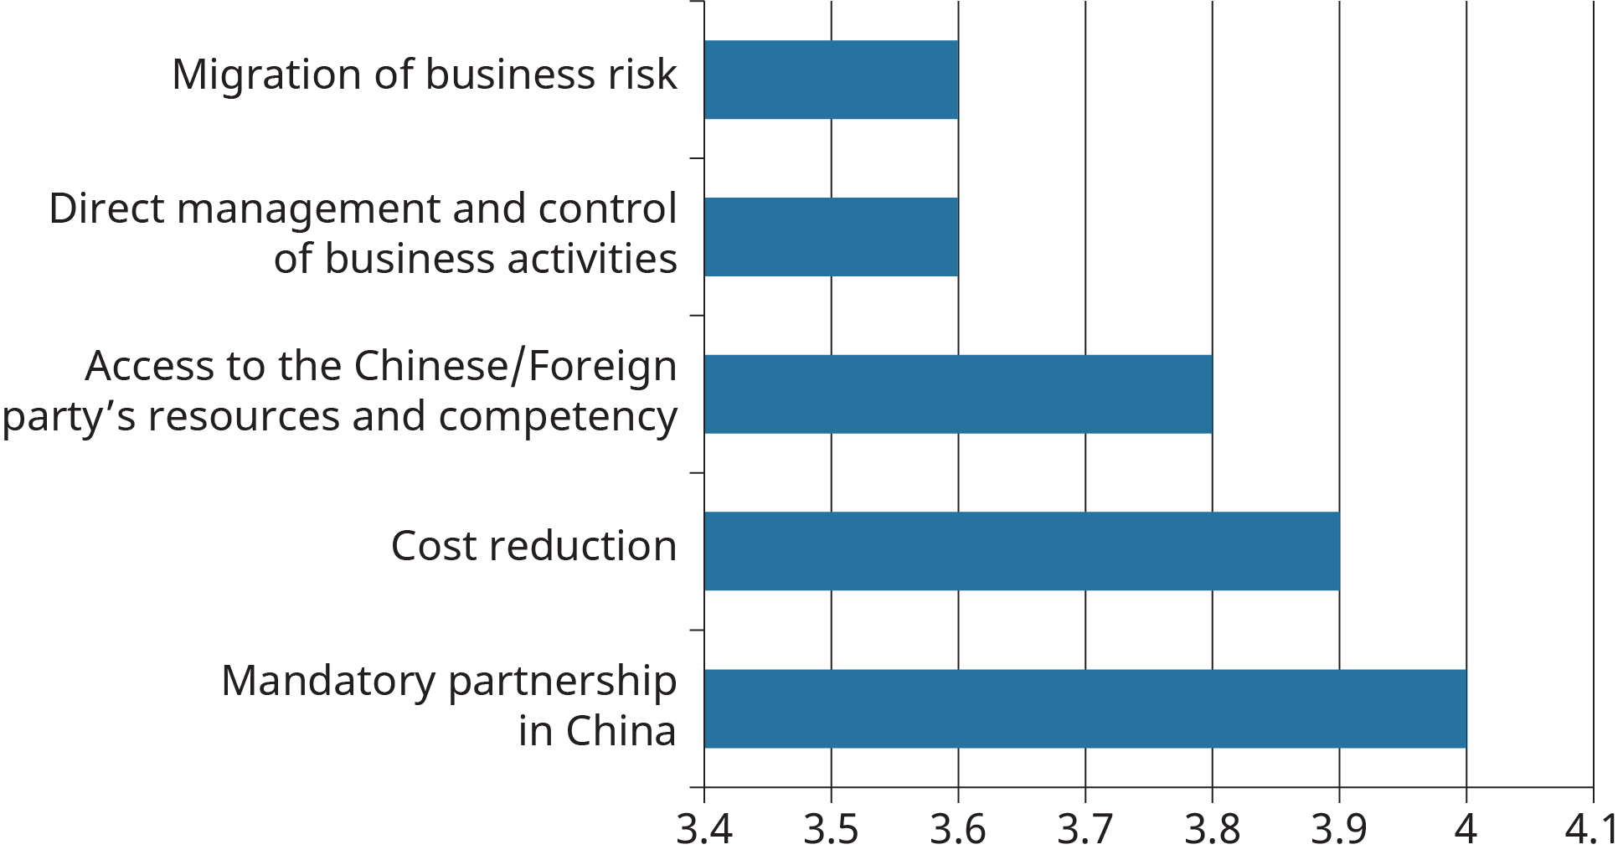
Exhibit 6.8 Reasons to Enter Strategic Alliances
Based on PWC, 2015, “Courting China Inc: Expectations, pitfalls, and success factors of Sino-foreign business partnerships in China,” http://www.pwccn.com/webmedia/doc/635705701963346674_china_joint_venture.pdf

Slide 25
7. Why might it be necessary for a company to go international, and how might it accomplish this goal?
Concept Check
What are the factors and approaches that organizations can take when deciding to go global?
License, Franchise (page 191, 192)
This OpenStax ancillary resource is © Rice University under a CC-BY 4.0 International license; it may be reproduced or modified but must be attributed to OpenStax, Rice University and any changes must be noted.

