Slide 1
Principles of Management
Chapter 17 Organizational Planning and Controlling

Slide 2
Over the weekend I was reading Car and Driver and there was a quote from Frank Hawley NHRA driving instructor that said
“You will never get better until you realize your not good.”

Slide 3
Planning
This 6:00 video, zeroes in on Strategic Planning using a diagram to display on one whiteboard the entire process.
View the video, review Section 17.1, and then think about strategic planning.

Slide 4
Planning
Break into groups of 4
Decide on an organization that where you will develop a strategic plan.
MU College of Business club
MU athletic department
Big Baller sports company
Starbucks
ESPN

Slide 5
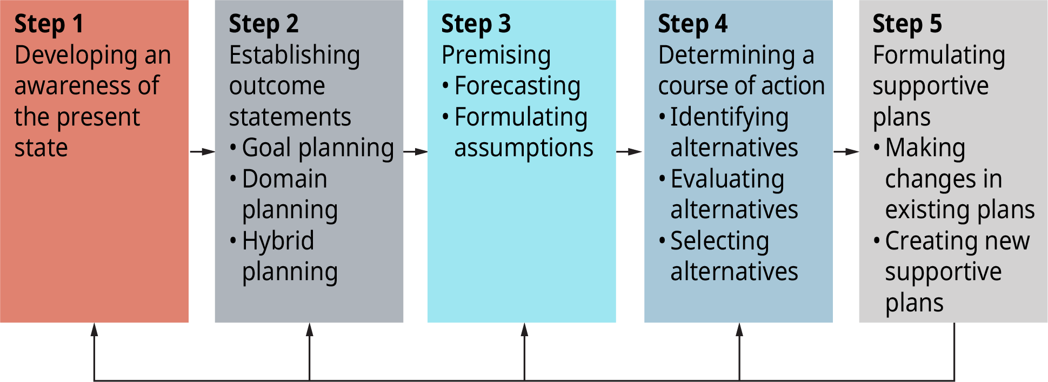
Exhibit 17.3 The Planning Process
Source: Adapted from H. Koontz and C. O’Donnell, 1972. Principles of management: An analysis of managerial functions. New York: McGraw-Hill, 113.

Slide 6
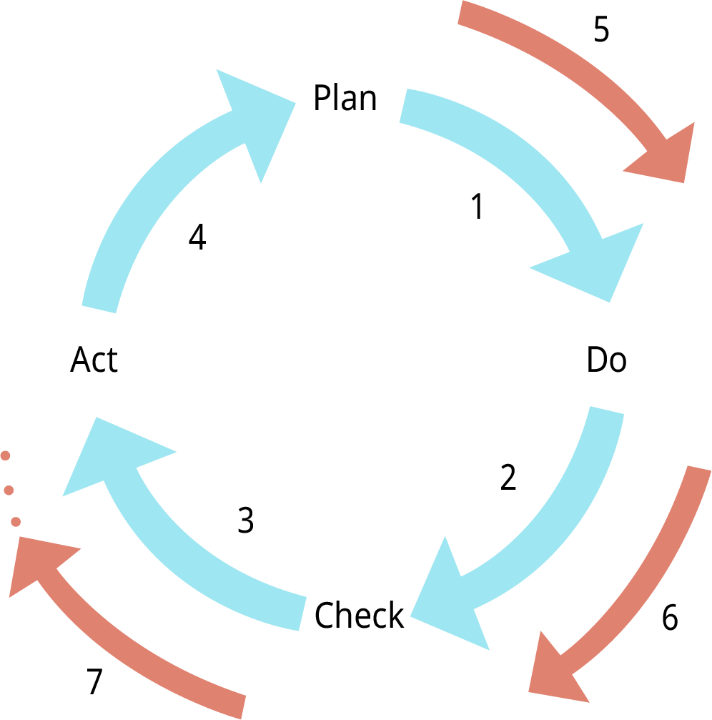
Exhibit 17.6 The Deming (Shewhart) Cycle
(Attribution: Copyright Rice University, OpenStax, under CC-BY 4.0 license)

Slide 7
Planning
Write down your personal PLAN
What job will you have at 25?
How much money will you make?
Job at 25 | Income

Slide 8
Planning
Write down your personal PLAN
What job will you have at 35?
How much money will you make?
Job at 25 | Income
Job at 35 | Income

Slide 9
Planning
Break into groups of 3
2 give advice to the 1 on PLANNING (using 4 steps) to get from 25 to 35.
Awareness of present state
Goal Planning
Premising (what assumptions are you making?) The quality of any plan depends on the assumptions you make about the future.
Determining course of action
Identify alternatives
Evaluate alternatives
Select alternatives

Slide 10
The Planning Process
Watch this 6:00 video in which the presenter, uses homemade visuals to explain PDCA, and how it can be applied to virtually any situation, professional and personal.

Slide 11
The Planning Process
Can you think of any applications for Plan>Do>Check>Act that make sense for you in your life, at work or at home?

Slide 12
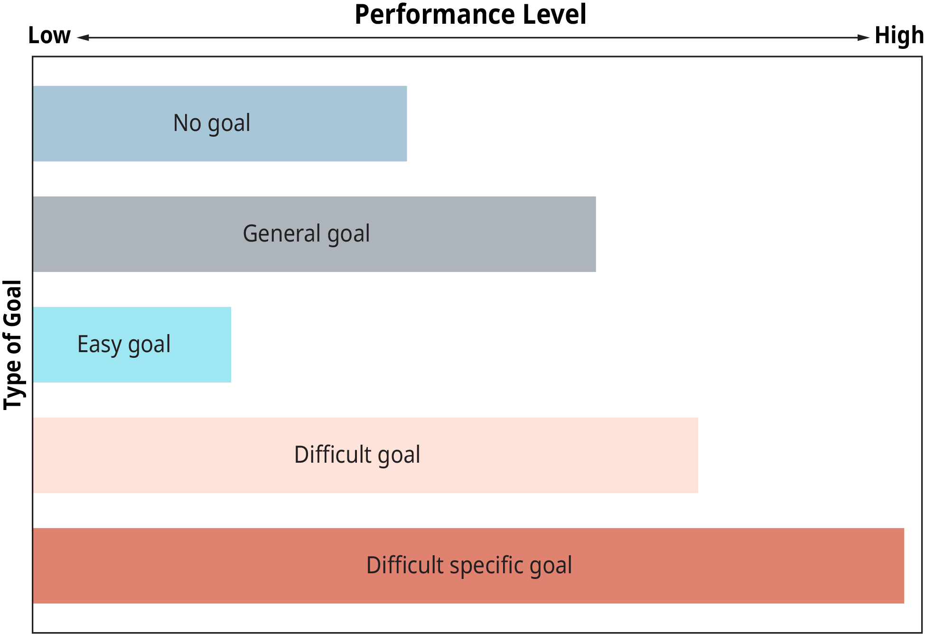
Exhibit 17.9 The Effects of Goals on Performance
(Attribution: Copyright Rice University, OpenStax, under CC-BY 4.0 license)

Slide 13
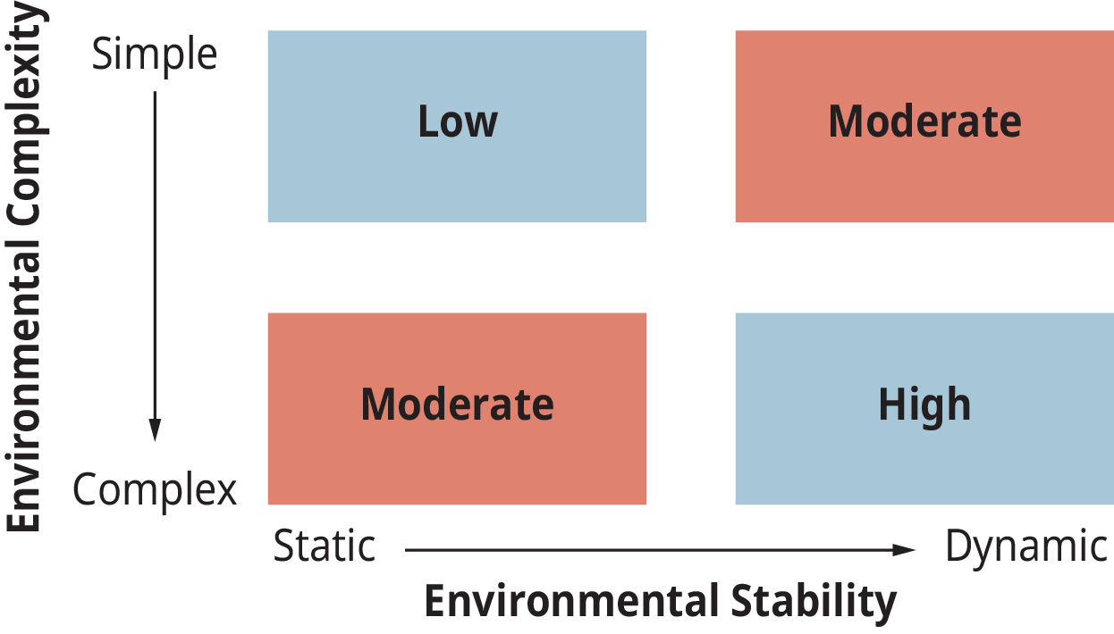
Exhibit 17.13 Need for Control
(Attribution: Copyright Rice University, OpenStax, under CC-BY 4.0 license)

Slide 14
Exhibit 17.14 The Traditional Control Model
(Attribution: Copyright Rice University, OpenStax, under CC-BY 4.0 license)

Slide 15
The Gap Between Planning and Doing
After reviewing this information in the chapter view this 13:00 video, in which Kirsten Rohde, Professor of Behavioral Economics at Erasmus University Rotterdam, claims that all people suffer from a gap between planning and doing, in other words, plans made are not plans fulfilled.
Stop at 4:00

Slide 16
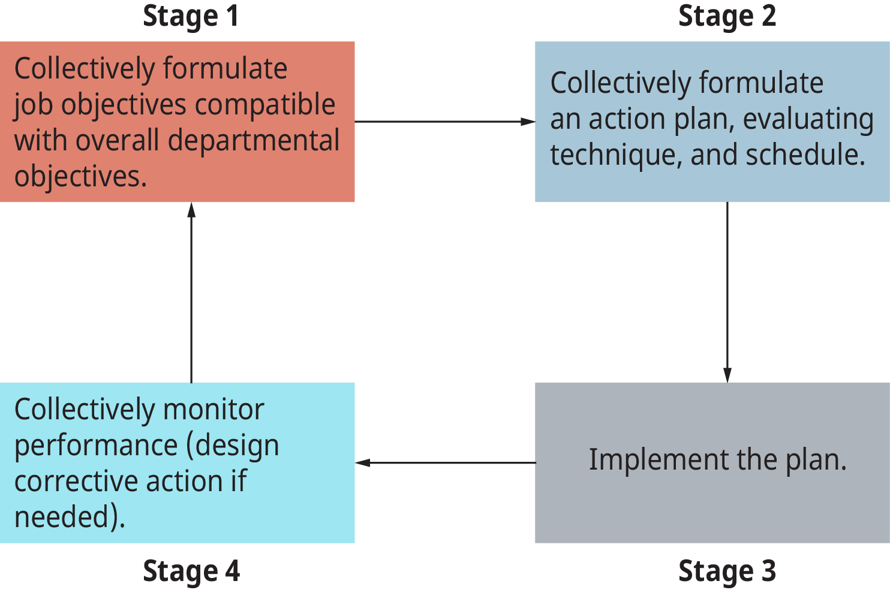
Exhibit 17.17 The Management by Objective (MBO) Process
(Attribution: Copyright Rice University, OpenStax, under CC-BY 4.0 license)

Slide 17
Exhibit 17.17 The Management by Objective (MBO) Process
Class Project – How do you grade for innovation?
Consider that failure is required for innovation.
Example - % sales from new products
(Attribution: Copyright Rice University, OpenStax, under CC-BY 4.0 license)

Slide 18
7. Describe management by objectives as a philosophy and as a management tool/technique; describe its effects.
What is management by objectives?
Management by objectives (MBO) concerns the relationship between employee involvement and job satisfaction. The employee’s involvement leads the person to experience work as more meaningful because he or she satisfies higher-order personal needs. This, in turn, results in increased motivation and performance. It is used in a collaborative work environment. Employees monitor their own performance and set course corrections if they are not reaching the goals they and their manager agreed to.

