Slide 1
Principles of Management
Chapter 16 MANAGERIAL COMMUNICATION

Slide 2
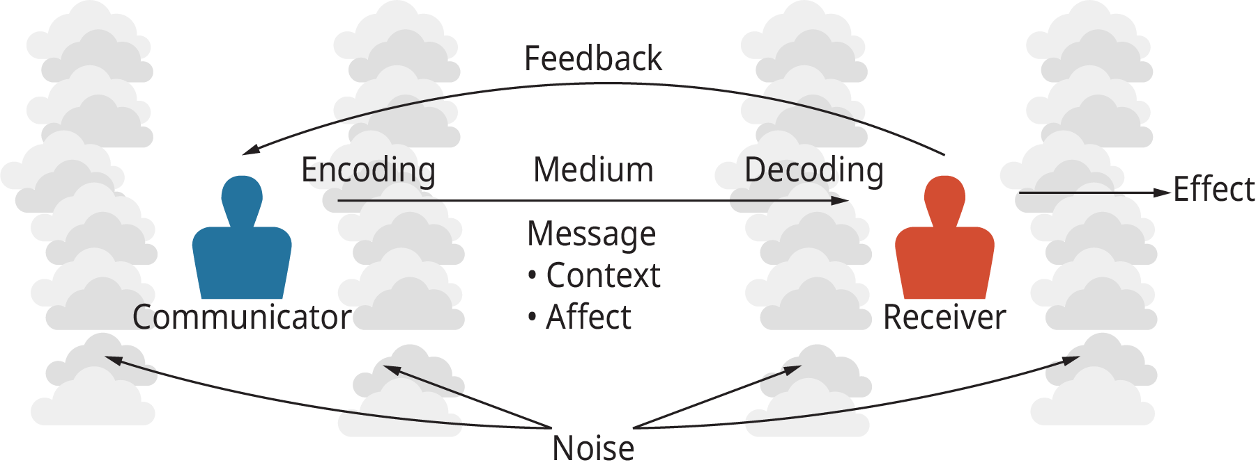
Exhibit 16.2 The Basic Communication Model
(Attribution: Copyright Rice University, OpenStax, under CC-BY 4.0 license)

Slide 3
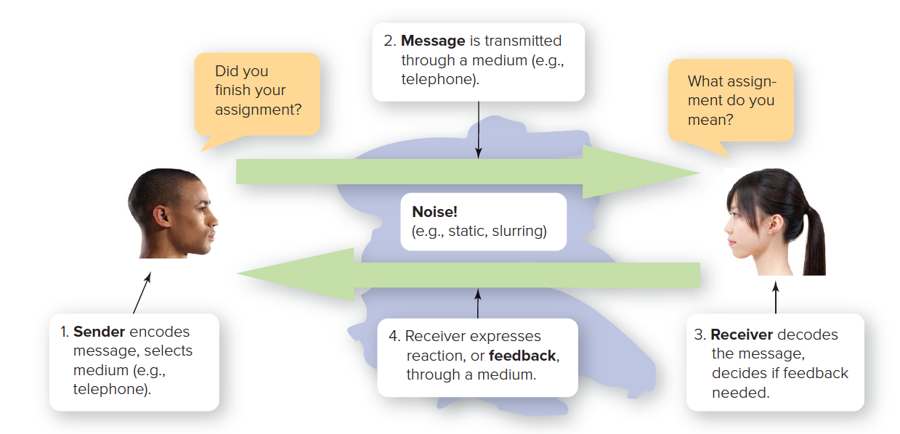
The COMMUNICATION PROCESS
Figure 15.1
Access the text alternative for these images.
(male): © Fuse/Getty Images; (female): ©Comstock Images/Alamy Stock Photo
Notes:
Encoding is translating a message into understandable symbols or language. Decoding is interpreting and trying to make sense of the message.

Slide 4
Abbott and Costello
View this 2:30 video highlighting an old routine from one of the 20th Century’s most famous comedy teams of Abbott and Costello, which illustrates how both sender and receiver need to be in sync to foster good communication.

Slide 5
Who is yu / you joke https://www.instagram.com/reels/audio/1561860084170952

Slide 6
Abbott and Costello
What barriers must you overcome to communicate at Manchester University?
Describe any strategies you have created to overcome these barriers. Are these challenges unique to higher education, or have you experienced similar issues at a job, or with your friends, family and acquaintances?

Slide 7
Abbott and Costello
Looking at these barriers to effective communication, can you think of at least one “work-around” or solution to each one that a manager could implement? 7 groups.
Communication Barrier | Possible solution or “work-around”?
Sender
Encoding
Message
Medium
Decoding
Receiver
Feedback
Noise

Slide 8
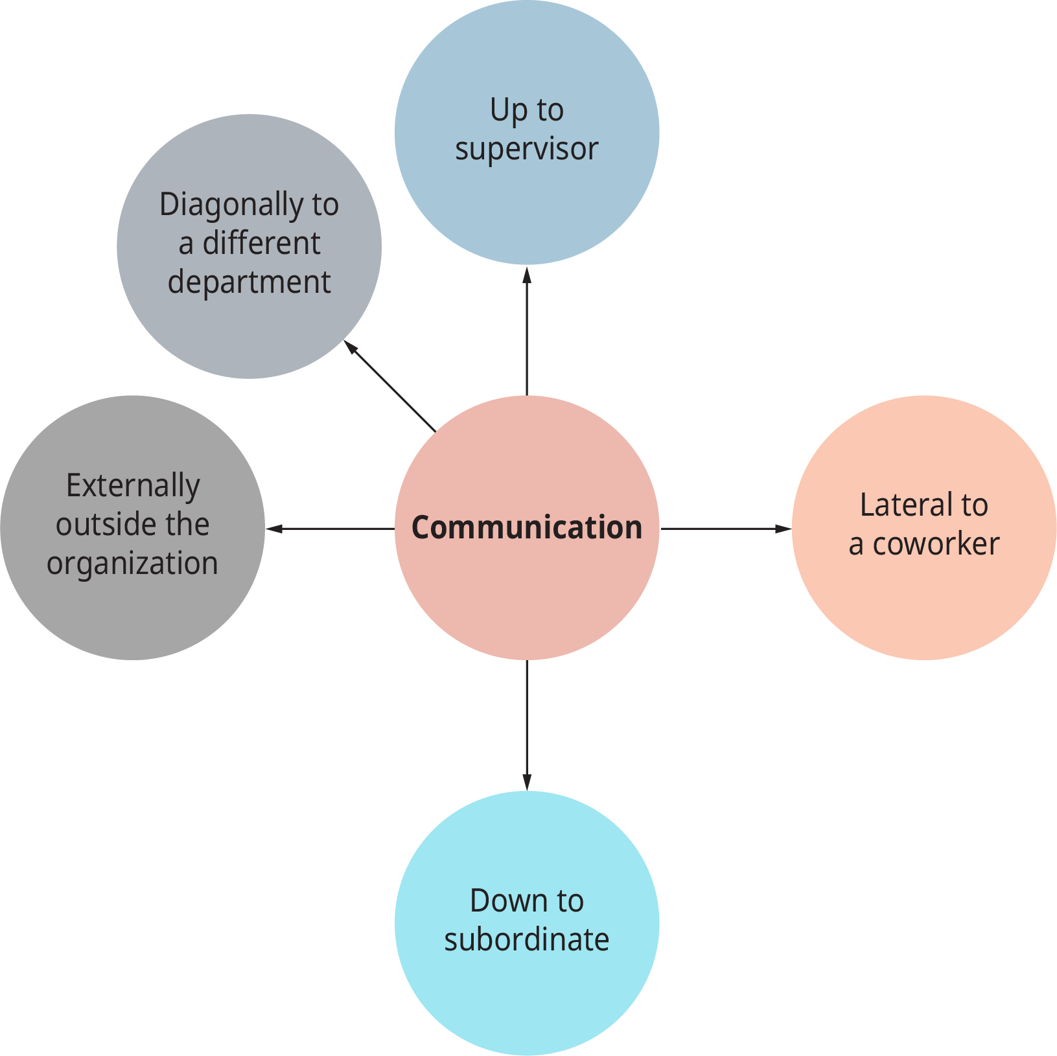
Exhibit 16.4 Patterns of Managerial Communication
(Attribution: Copyright Rice University, OpenStax, under CC-BY 4.0 license)

Slide 9
Coming to America
View the 1:40 video from the film Thousand words and notice how the character Eddie Murphy plays uses gestures in an attempt to communicate non-verbally.

Slide 10
Thousand words
How would you rate the success of this way of communicating, based upon the scene in the video?
What advantages and disadvantages are part of using gestures instead of words?
How might nonverbal communication be misunderstood?

Slide 11
3. Understand how power, status, purpose, and interpersonal skills affect communications in organizations.
Concept Check
What are the major roles that managers play in communicating with employees?

Slide 12
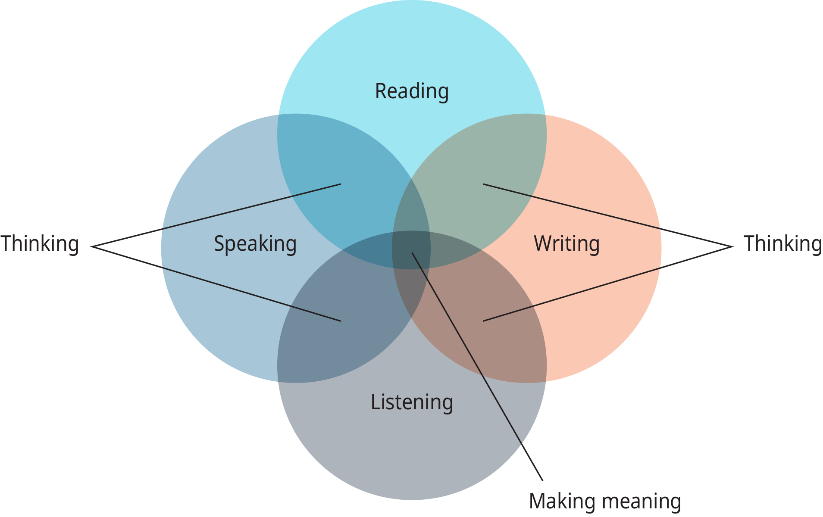
Exhibit 16.6 Reading, Writing, Speaking, and Listening: How They Help in Creating Meaning
(Attribution: Copyright Rice University, OpenStax, under CC-BY 4.0 license)

